Slide 1


BRT Road Cameras Faster and Safer
Group member | ID
Mohammad Roshdi Khatatbeh | 0189721
Tsneem Abdeljaleel Alzboon | 0192212
Ayat Mohammad Alsheikh | 0195384
Zaid Mazen Aburasheid | 0206186
Dina hisham Alalawneh | 0187733

Slide 2
Summary
After lunching Bus rapid transit (BRT) project in 2021 it served thousands of citizens during last year, but some people complained about some issues that they faced during using this transport system such as safety, availability, and the late arrival.
So, we had thought for a solution for those problems to make the (BRT) more efficient by using cameras beside the traffic lights that are in the bus route and connect them to an AI system to control the traffic lights, do some calculations and for monitoring. and with an application to provide the passengers with useful information.
This will improve the level of the BRT performance to become the best transport system you can use.

Slide 3
Objectives
 AI system connected with cameras will detect the bus from long distention and it will give access and priority for the bus by turning other path traffic lights to red before the bus arrive, so it won’t need to waste time on stopping on road intersections.
 Al system will detect the number of passengers in the bus and the bus speed on the road that will alert the system if there are any violations for safety guarantee.
 Improving availability: the cameras will do some calculations by detecting the number of the passengers in every path to provide the path with right number of vehicles it needs.
 Application service connected with the cameras fortracking nearest bus and nearest riding points to the user.

Slide 4
Beneficiaries
Passenger: It’s all about making the passenger reach his destination safely and as fast as possible so the more efficient the BRT is the more passenger will use the bus .
Government: when the project works more efficient more citizens will use it and that will increase the revenue.
The traffic: more citizens will use the BRT instead of their cars to save time, and by applying the full control of the traffic lights it will make the traffic move faster.

Slide 5
Impact summary
Lately the population number in Jordan is growing so fast in the last 10 years because of the immigrants and the born rate and this huge number of people in a small city like Amman has made traffic issues that effected our life in so many ways, people are getting so late for their jobs, schools, and collages because of the slow flow of the traffic.
So, we must decrease the number and the usage of the vehicles on the roads, But how?
After the BRT improvement we have to persuade people for using the BRT instead of using their cars to go to the daily rides by posting the benefits of using the bus instead of their cars and how this will affect their time and will cost less money and will make less population and much more.
It’s the time for the BRT to become the first transport system used in Jordan.

Slide 6
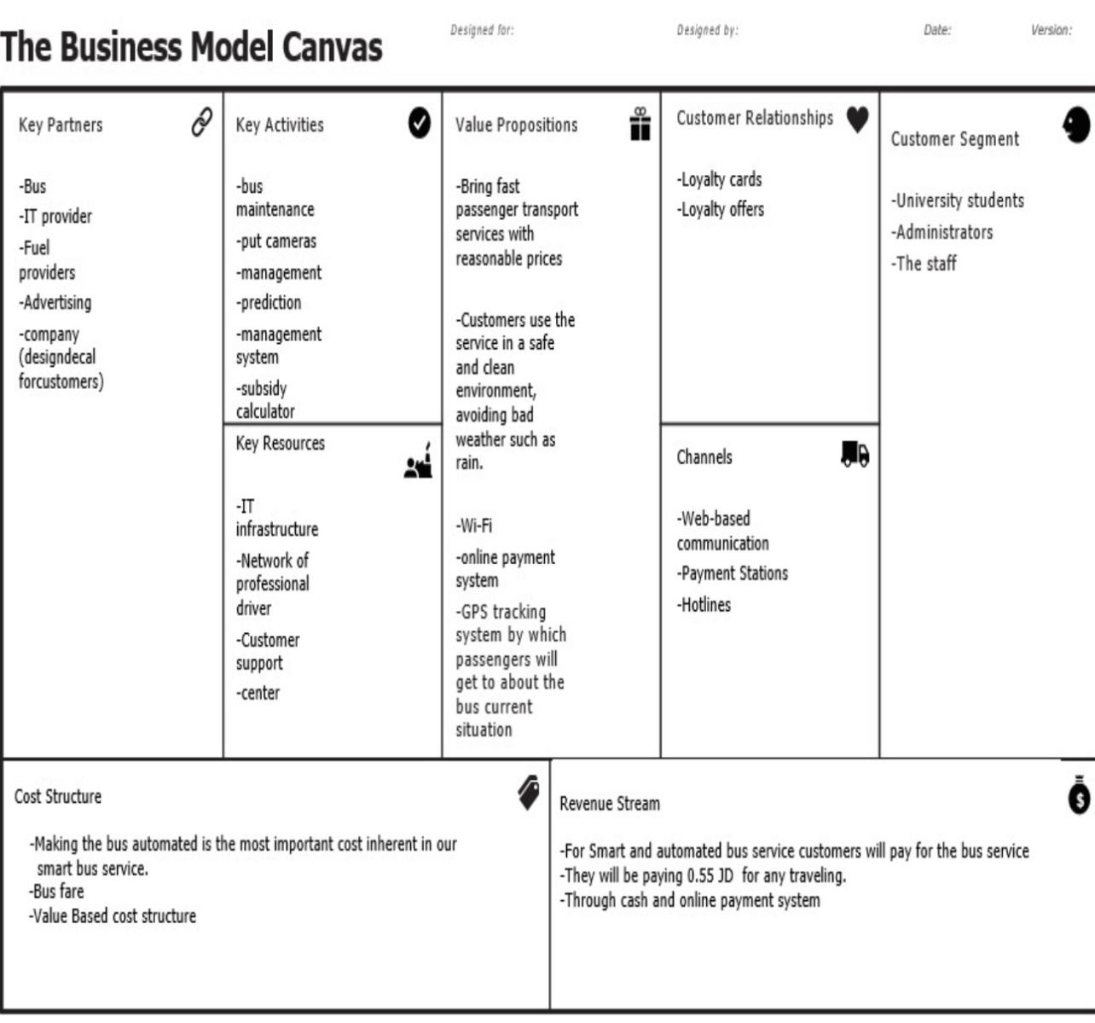
Business model

Slide 7
Required Rresources
Smart Cameras: used on the traffic lights that is connected to the AI system
AI system: do some calculations and detections
More buses: AI will count the need for each track
Staff: AI programmer, engineers, bus drivers.
control offices: watch the AI system workflow.

Slide 8
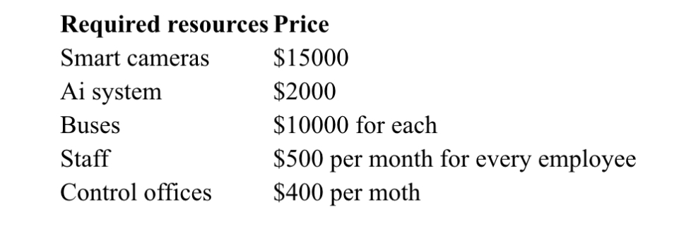
Project’s Budget

Slide 9
Justification of Resources
Cameras are needed at every traffic light in the Bus Road to provide the AI system that is connected to with the information needed.
AI system that is connected to the cameras will do calculations, monitoring, recognition, and control the traffic lights.
Staff will help in programming the system, connect the AI with cameras, camera installation, daily checking out and repair.
Extra buses for meeting people need.
Control offices we can’t fully trust the Ai, so we need control offices to monitor the whole process.

Slide 10
Methodology
Name | Work package | Priority | budget | description | status | Directed path | Potential | Step
Mohammed | Programming | High | 2000 | Develop a full functional system | Open | None | High | 1
Zaid | Leading and logistics | High | 500 | Making it familiar with funding agencies | Open | Government | High | 2
Tsneem | Marketing and word spreading | High | 500 | Attract citizens | Open | Feedback to office | High | 3
Ayat | Customer care | High | 500 | Helping to have loyal and a happy client | Open | Feedback to office | High | 4

Slide 11
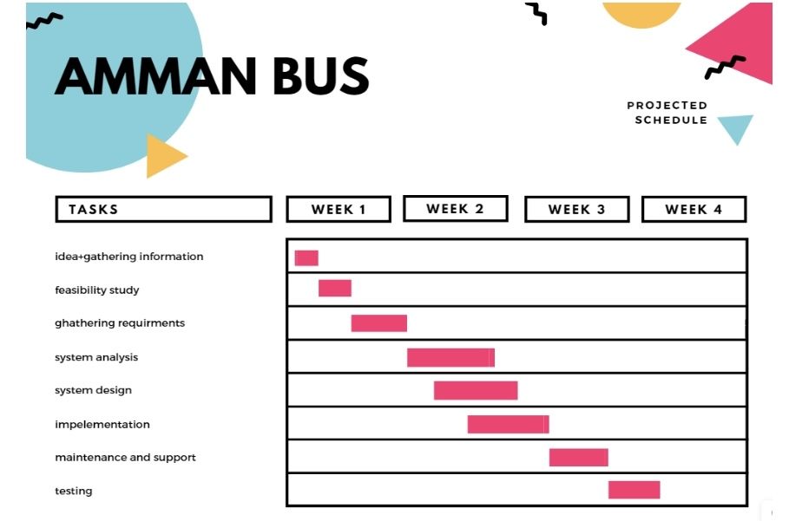
Project’s Timeline

Slide 12
Project Customers
All the citizens that need to transport around the city
Funding Opportunities
Government will be the main supporter to improve their BRT project and solve the traffic problem
Transport companies (JET) they may support the project with the buses that they have

Slide 13
References
https://medium.com/seed-digital/how-to-business-model-canvas-explained-ad3676b6fe4a
http://www.ammanbrt.jo/

